Slide 1







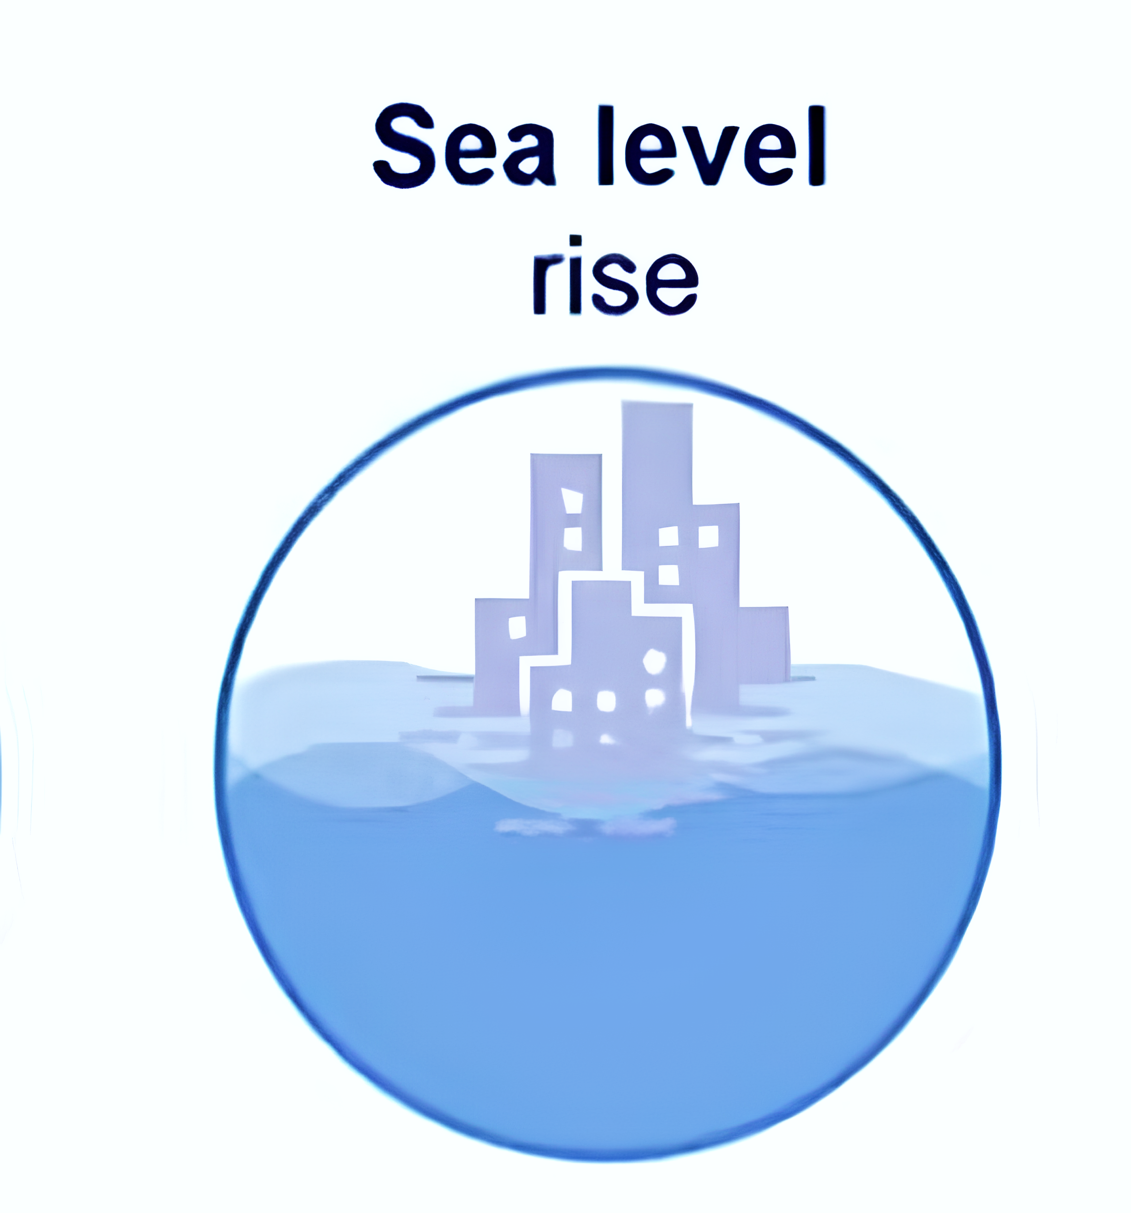
Greenland ice sheet
Sea level budget in light of recent observational advances since 1960
Glacier
Antarctica ice sheet
Ocean expansion
Land water storage
Huayi Zheng¹, Lijing Cheng¹, Sönke Dangendorf², Benoit Meyssignacd³,
Anne Barnoud⁴, Kevin E. Trenberth⁵, John T. Fasullo⁵, John Abraham⁶,
¹Institute of Atmospheric Physics, Chinese Academy of Sciences
²Department of River‐Coastal Science and Engineering, Tulane University
³LEGOS
⁴Magellium, Ramonville-Saint-Agne
⁵National Center for Atmospheric Research
⁶University of St. Thomas
Notes:
Identifying the causes of sea-level change and constraint projection
Cross-validating for worldwide complex observing systems

Slide 2
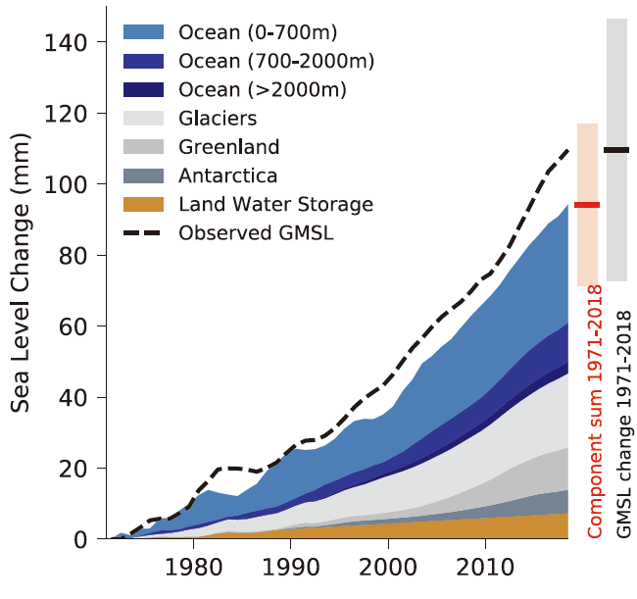
Sea level budget challenge: incomplete closure
The global mean sea level (GMSL) budget is crucial for
understanding the drivers of sea level rise, but remarkable misclosure remains.
The identified driver of GMSL
Observed GMSL
Greenland ice sheet
0.33 mm yr⁻¹
Glacier
Antarctica ice sheet
Greenland 0.25 mm yr⁻¹
Antarctica 0.14 mm yr⁻¹
Ocean expansion
Land water storage
Sum of contributions
(IPCC AR6)
Notes:
The major contribution of global mean sea level is unravelled in the past studies. The contributions include Greenland ice sheet,XXXXXXXXX. And we can explain why sea level rise combining estimates of these components. The right figure is from IPCC AR6，which summary the GMSL budget in past effort. The different color countrf represent different component. And the black line is GMSL changes. Although the sum of contributions matches the observed GMSL within uncertainty, there remains a substantial residual between the observed GMSL and the sum of the components: 0.33 mm yr⁻¹ over 1971–2018, which is larger than the contribution from the ice sheets alone. So the budget is incomplete.

Slide 3
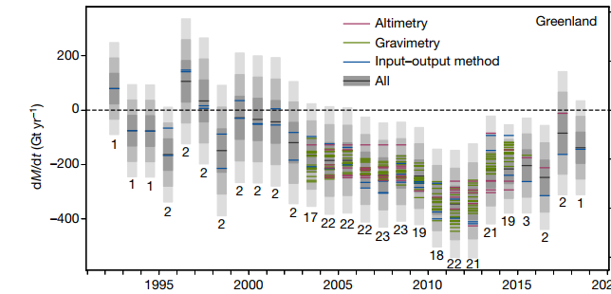
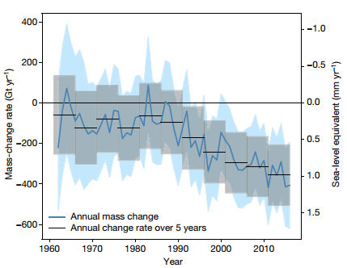
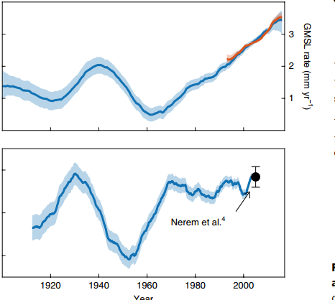
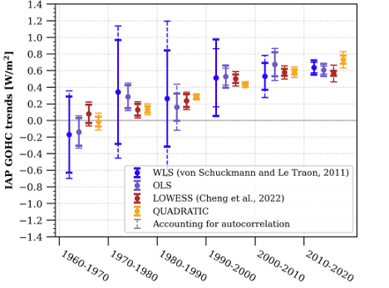
Sea level budget challenge : unexplained acceleration
GMSL rise is accelerating, what are the key drivers？
Greenland ice sheet mass loss rate
Glacier mass loss rate
GMSL rate
(Shepherd et al., 2020)
Ocean warming rate
(Zemp et al., 2019)
(Dangendorf et al., 2019)
(Minière et al., 2023)
Notes:
Actually, the trend of GMSL isn’t constant. The trend is increasing after 1960. So we said GMSL is accelerated. Also，the observation indicates ocean warming, Greenland ice sheet melting and Glaicer melting is accelerated. However, how these contributions contribute to GMSL acceleration remains unclear.

Slide 4
Two challenge in GMSL budget
Indication
The observed GMSL is strongly higher than sum of contributions.
The major drivers of GMSL acceleration are unclear.
The potential drift in earth system data
(Parkes & Marzeion, 2018; Barnoud et al., 2023; Cheng et al., 2024; Frederikse et al., 2017)
Recent progress in observation
?
The constrained tide gauge reconstruction
The updated drift solutions in altimetry
The improved estimate of ocean temperature
Reconciled estimate of glacier, ice sheet, land water storage (IMBIE, GlaMBIE)
Can recent progress in observation solve these challenge？

Slide 5
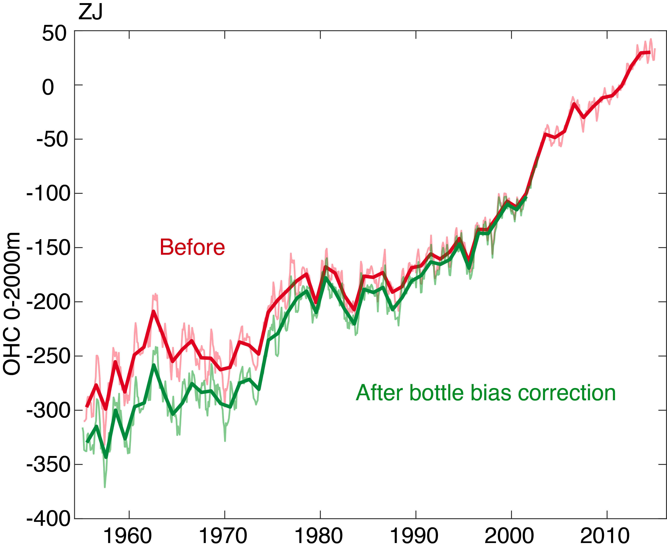
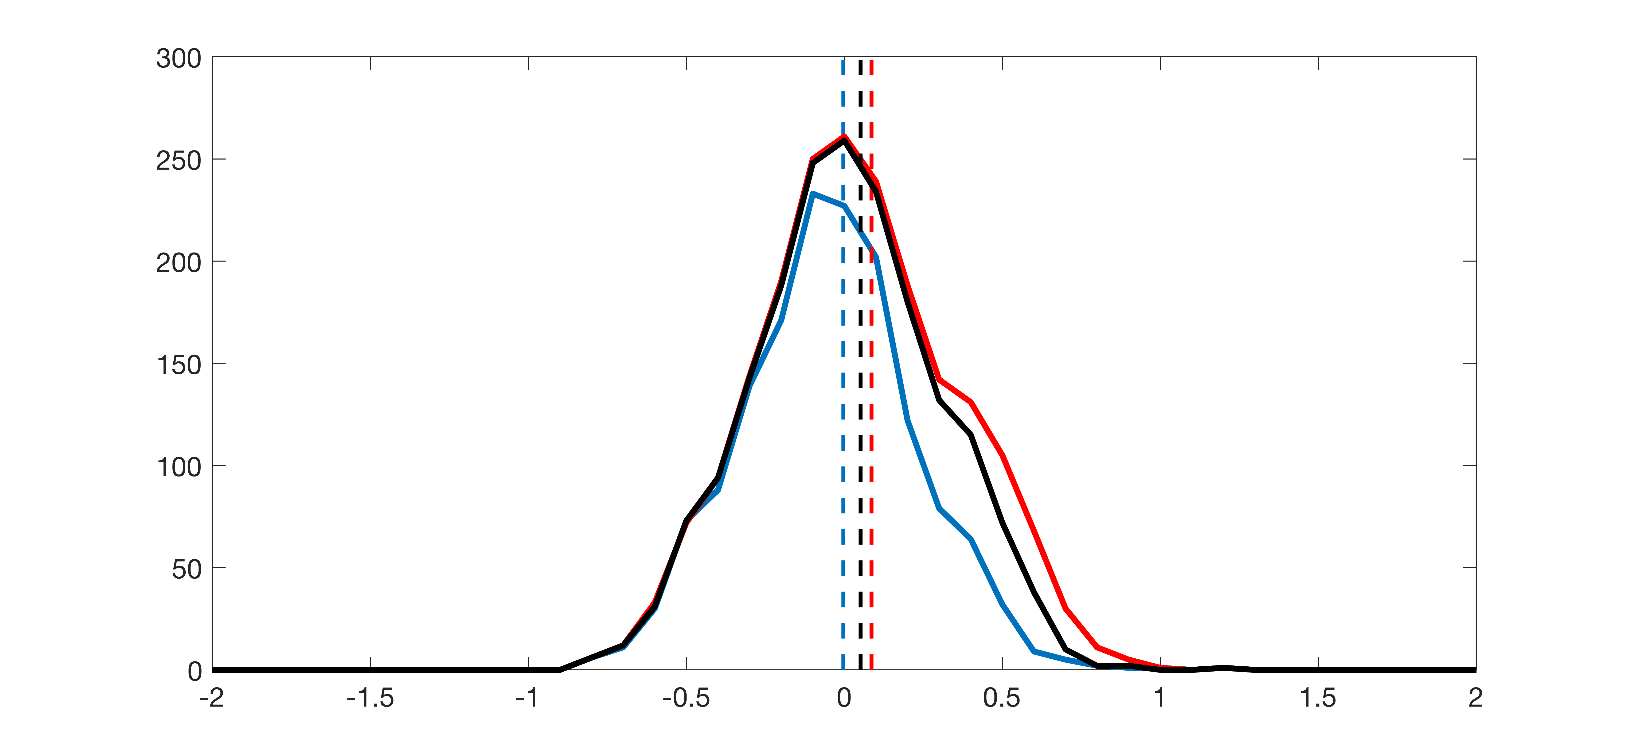
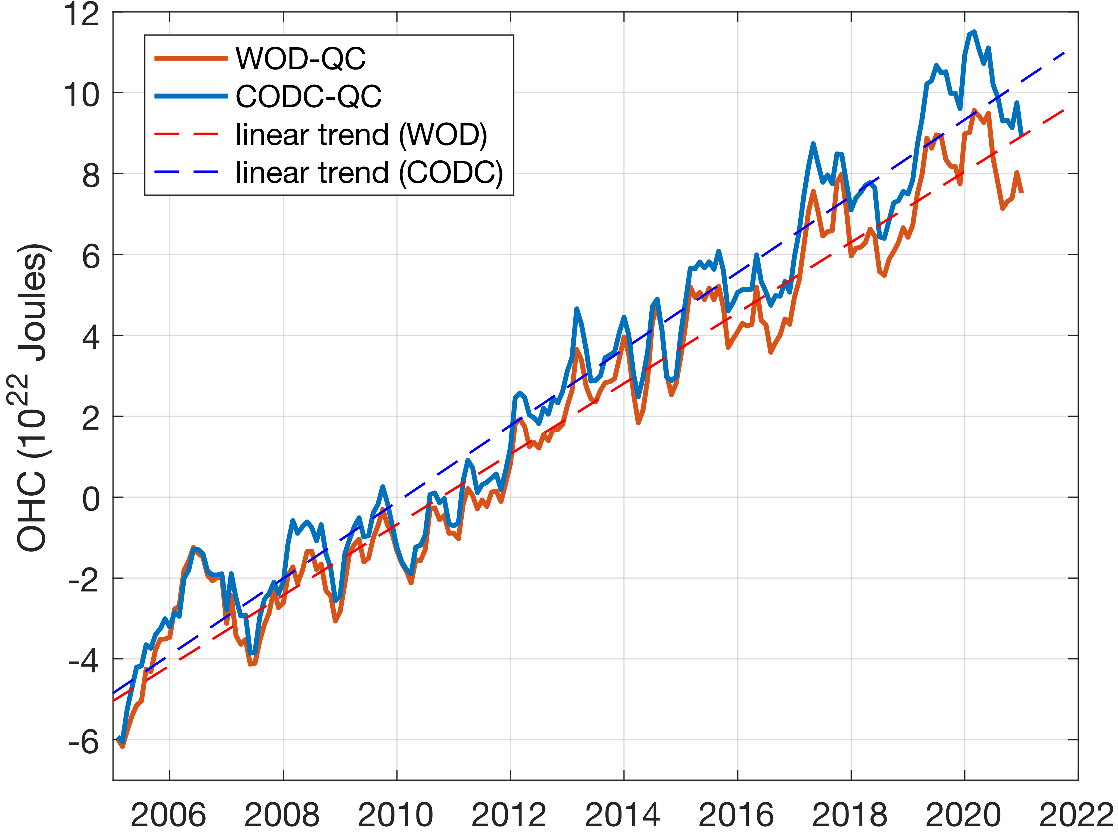
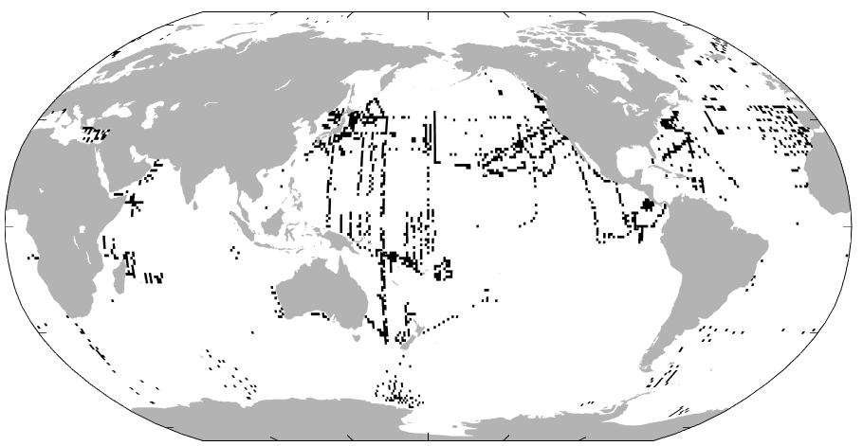
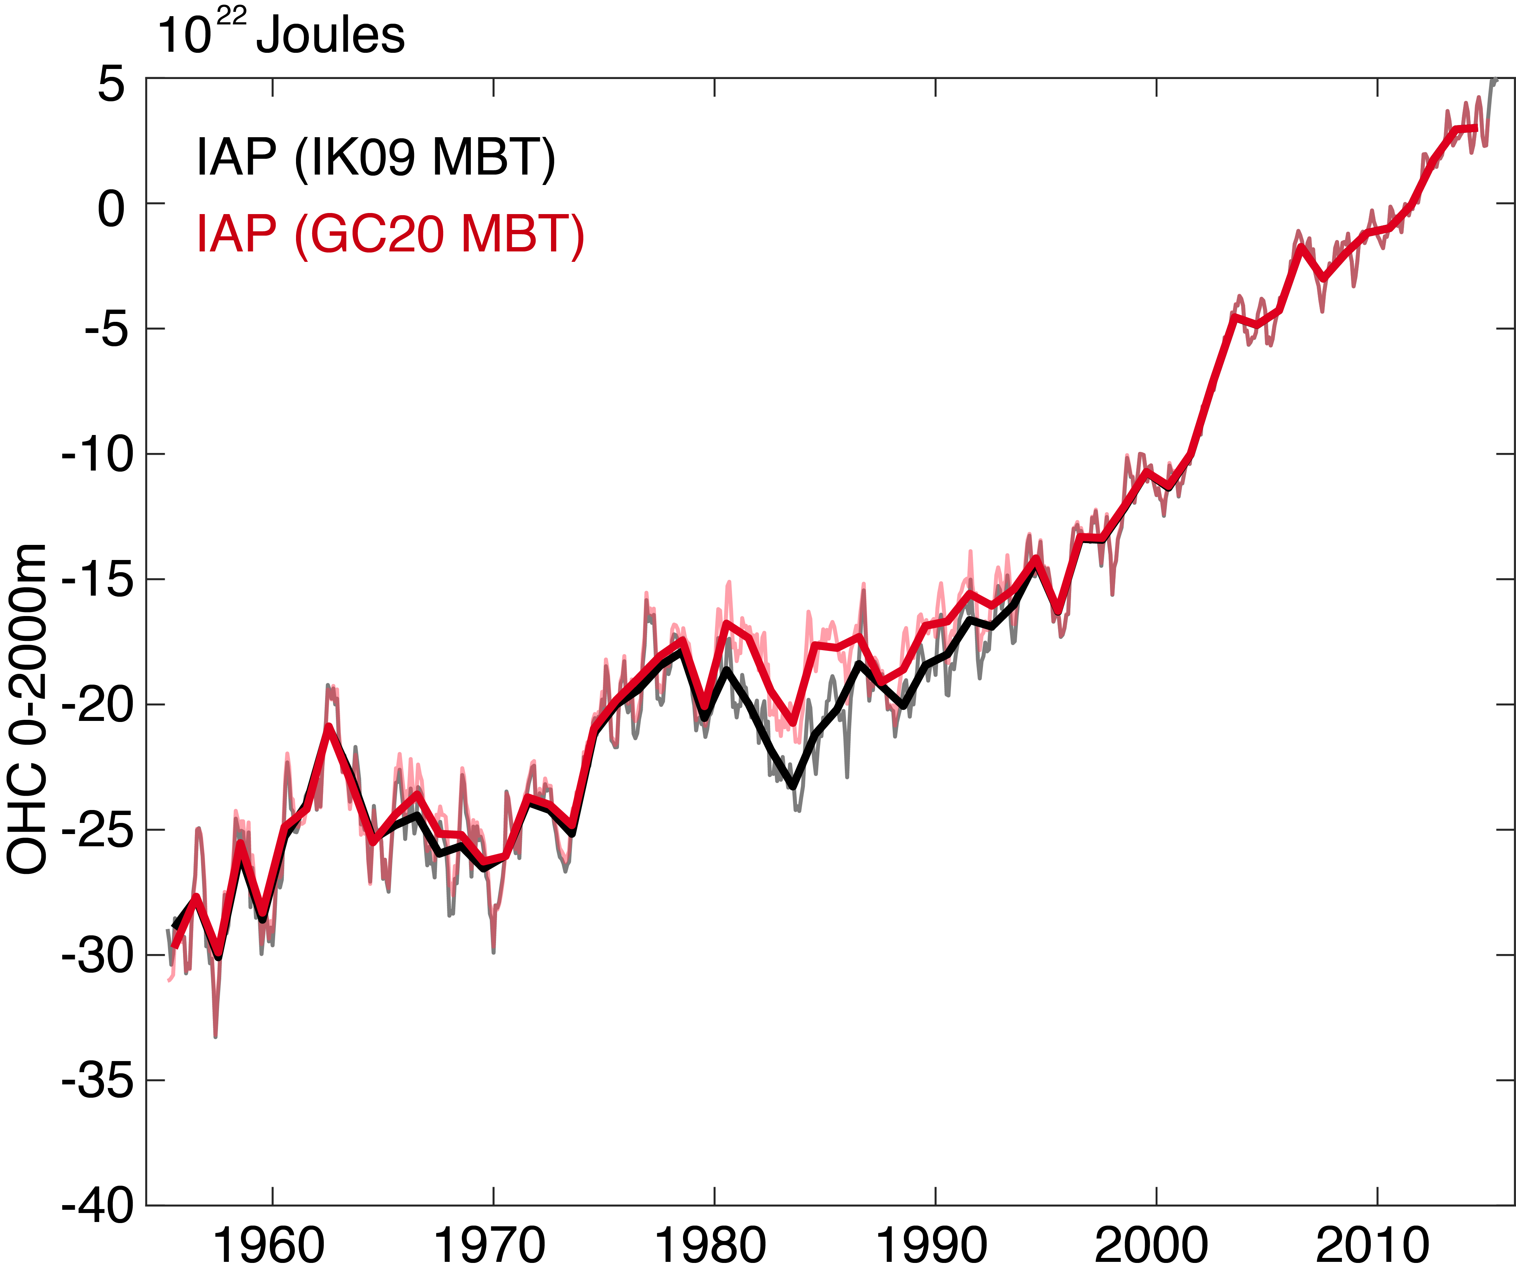
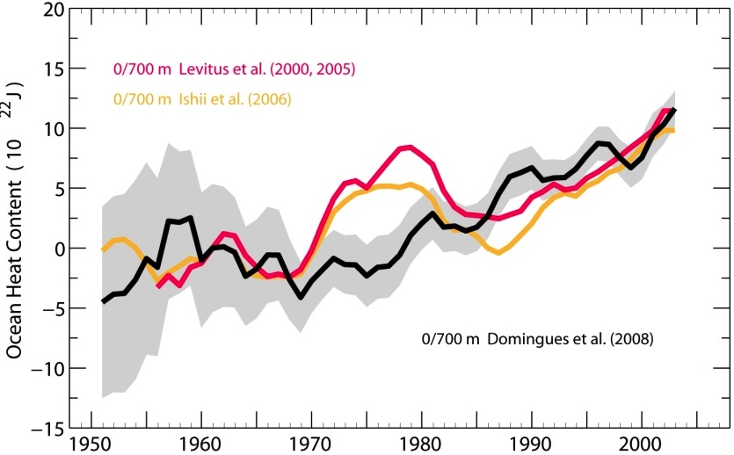
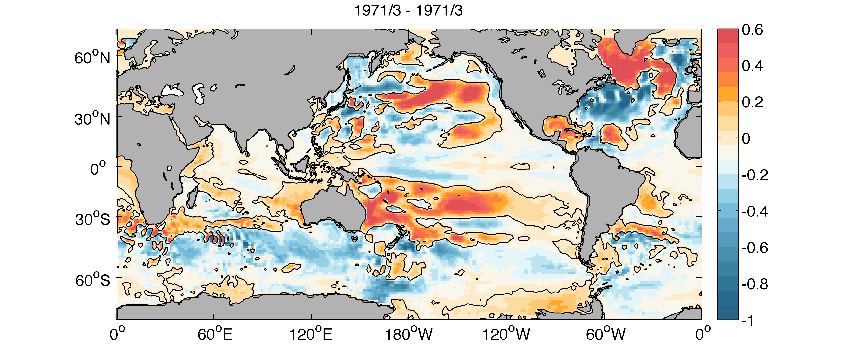
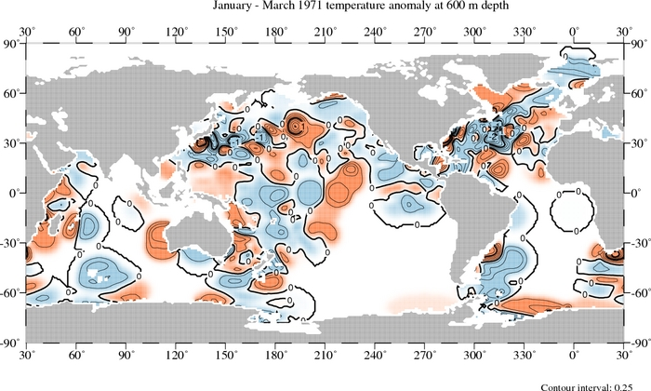
Steric (thermosteric) sea level: IAPv4.2 T data (Cheng et al. 2024 ESSD)
CODC Quality-Control (Tan et al., 2023)
Non-Gaussian assumption in local climatology range
Account for climate change trend in check threshold
Bias correction XBT/MBT/Bottle/APB (Gouretski et al. 2022, 2024, 2023, Cheng et al. 2014, 2018)
Bottle depth value is determined by wire length, thus biased
No Bottle correction
CODC-QC
CODC-QC
WOD-QC
WOD-QC
Bottle correction
~8% difference
Bias correction XBT/MBT/Bottle/APB (Gouretski et al. 2022, 2024, 2023, Cheng et al. 2014, 2018)
XBT/MBT depth and temperature measurements are biased
Mapping (Cheng and Zhu, 2016; Cheng et al. 2017 )
EnOI-DE method, capable unbiased reconstruct trends
ZJ
OHC0-2000m
No XBT correction
IAP
NOAA
IAP MBT correction
Max diff
~ 25 ZJ
After XBT correction
Ishii MBT correction
Notes:
First, we give a brief introduction about improved estimate of ocean temperature，IAPv4. It accounts for recent developments in raw observation data quality control (QC) bias correction and horizontal interpolation.
There is spurious data in intial observation. Tradition method use a constant threshold to identify spurious data. This method neglect ocean warming in threshold and eliminate some real data . We use a time-varing threshold to check data and find a stronger trend than it by 8%.
We find that there are systemic bias in certain observation instrument. And we do bias correction in popular instrument including XBT，MBT Bottle and APB.
The interpolate method is also improved. The tradition interpolte method follow “no observation no changes”. However, we find the changes in area without observation can be reconstructed by remote observation and climate model.

Slide 6
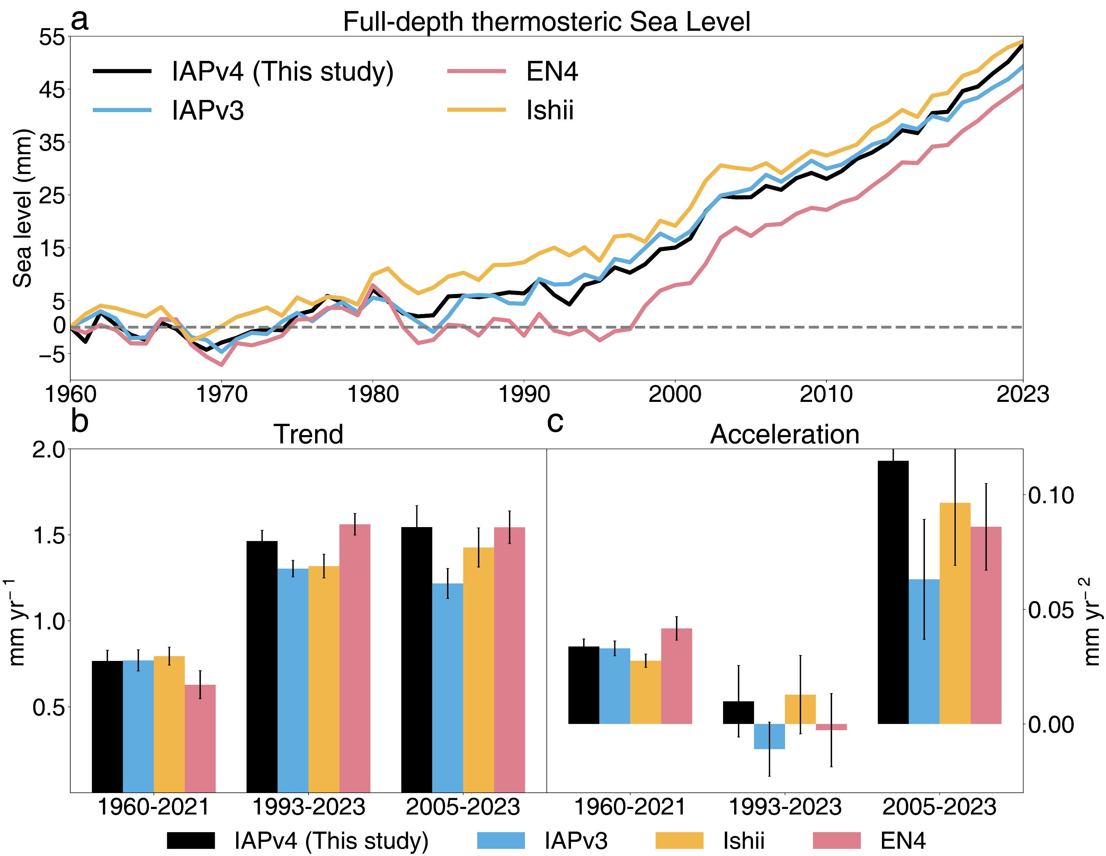
The improved estimate of thermosteric sea level
higher trend than many of the available estimates due to bias correction and mapping method
0.04 mm yr⁻¹ for 1960-2021
0.07 mm yr⁻¹ for 1993-2023
0.15 mm yr⁻¹ for 2005-2023
higher acceleration since 2005 (better consistency with TOA-EEI)
Notes:
Here is the results of IAPv4 data and other data contributed to IPCC AR6. Accounting for bias correction and interpolating method, IAPv4 data shows stonger trend than many available estimate. For example, higher by 0.15 mm yr-1 than mean of three estimate over 2005-2023. And steric sea level show acceleration in all analysised period, although is no siginicant over 1993-2023.

Slide 7
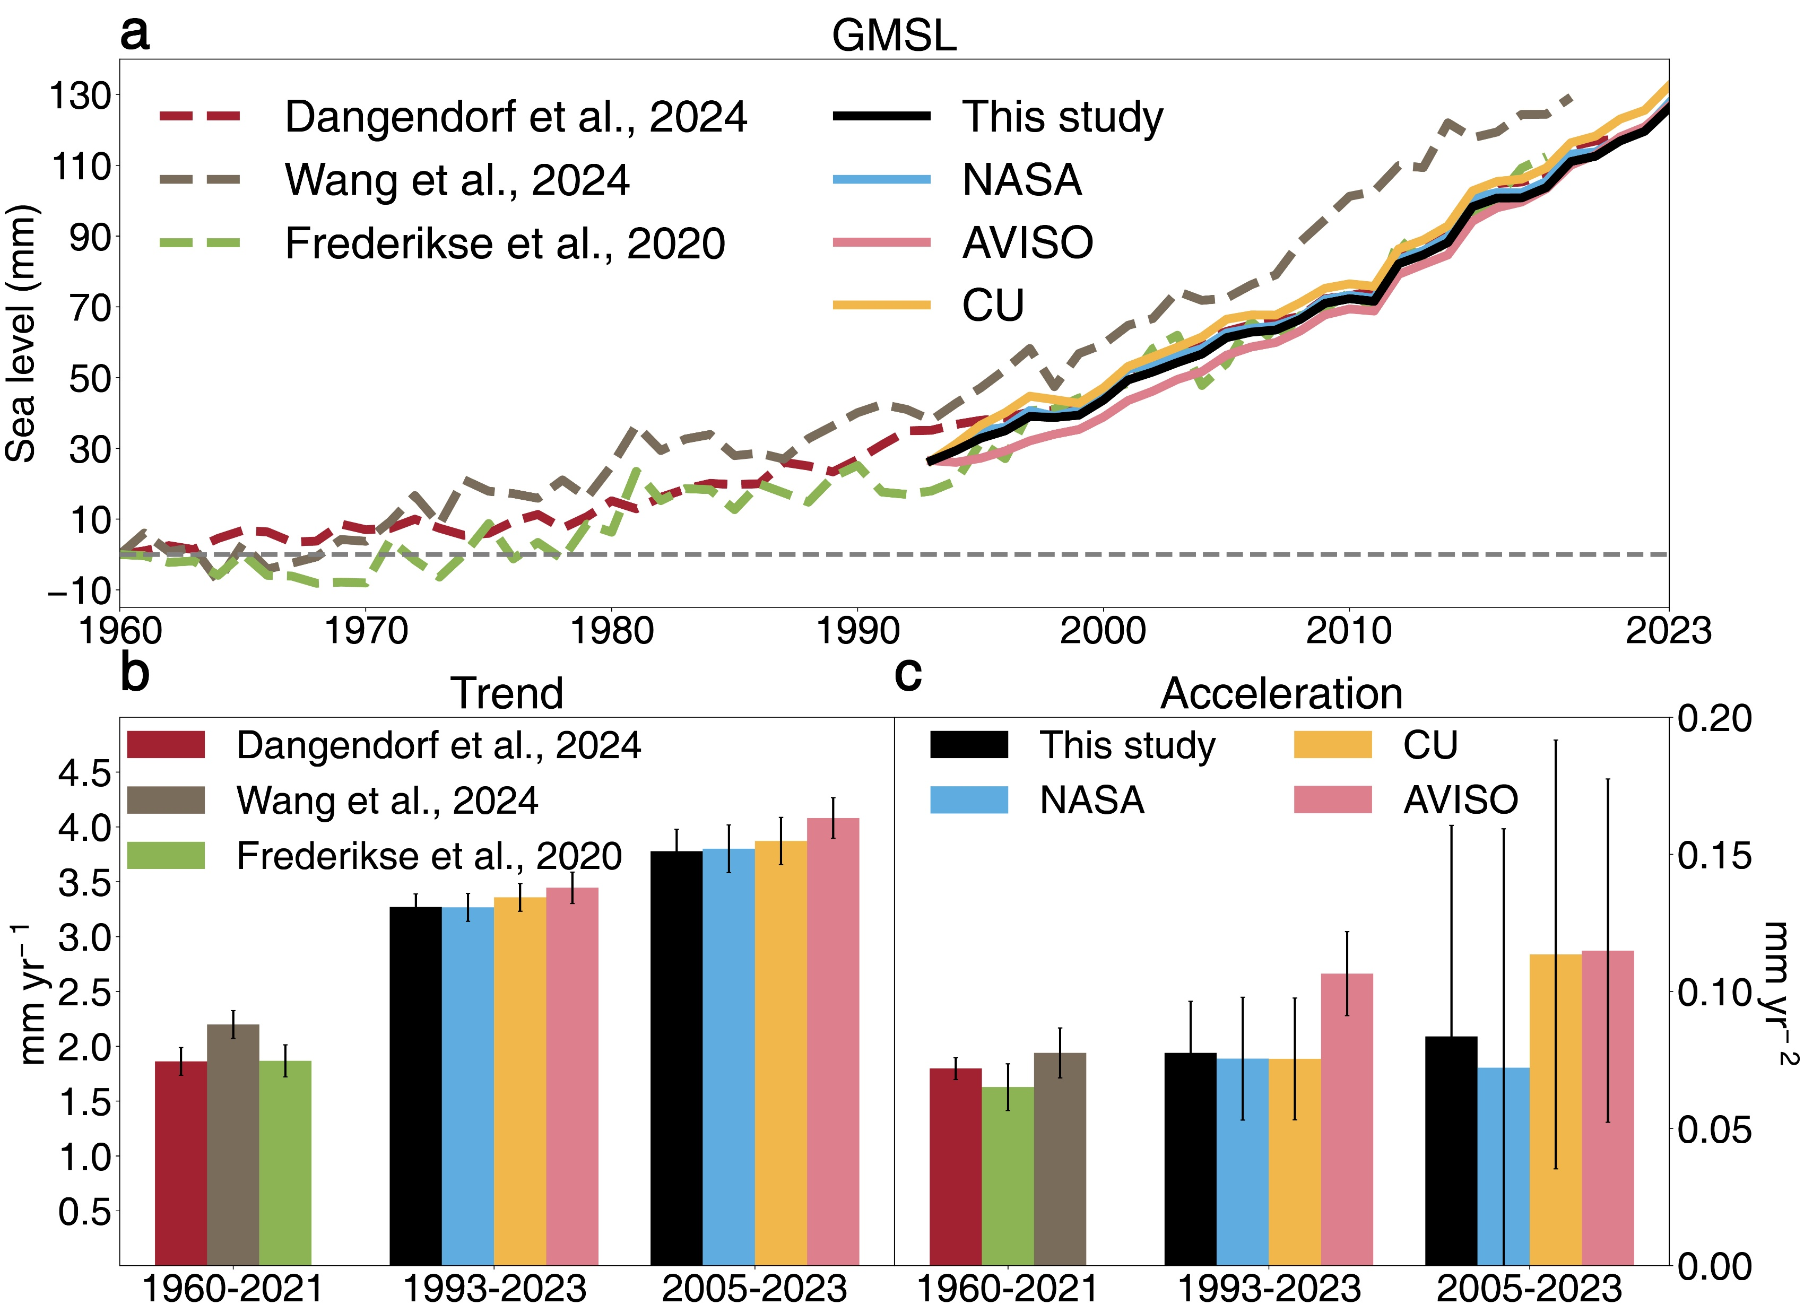
The improved estimate of observed sea level
The constrained tide gauge reconstruction shows lower trend since 1960.
0.01 mm yr⁻¹ compared with (Frederikse et al., 2020)
0.34 mm yr⁻¹ compared with (Wang et al., 2020)
The updated drift solutions in altimetry reduce trend and acceleration since 1993.
0.08 mm yr⁻¹ trend
0.015 mm yr⁻² acceleration
The updated estimate yields consistent acceleration for all analysed periods.
0.072 ± 0.005 mm yr⁻² for 1960-2021
0.083 ± 0.049 mm yr⁻² for 1993-2023
0.084 + 0.066 mm yr⁻² for 2005-2023
Notes:
Here is the new estimate of observed GMSL. We use Dangerdorf 2024 and altimetry after updated wet T C in our study. Dangerdorf 2024 updated tide guage reconstruction into 2021 and constraint GMSL with altimetry and dynamical progress. The trend is a litter lower than previous studies. The W T C is identified drift in Jason-3 satellite. The updated WTC method reduces trend 0.08 and acceleration by . And we find the acceleration in all anaylised periods is consistent within uncertainty after better process of data.

Slide 8
Other contributors: most up-to-date and comprehensive estimates
 | Data source | type
Glacier | 1960-2000 (Frederikse et al., 2020) 2000-2023 GlaMBIE | Reconciled ensemble observation Reconciled ensemble observation
Greenland ice sheet | 1960-1993 (Mankoff et al., 2021) 1993-2020 IMBIE 2020-2023 GRACE/GRACE-FO | Model Reconciled ensemble observation Satellite observation
Antarctica ice sheet | 1960-1993 (Medley & Thomas, 2019) 1993-2020 IMBIE 2020-2023 GRACE/GRACE-FO | Reconstruction based on ice core record Reconciled ensemble observation Satellite observation
Land water storage | WaterGAPv2.2e (Frederikse et al., 2020) | Hydrological model Statical reconstruction
Atmospheric water vapor | ERA5 | Reanalysis
Ocean mass | GRACE/GRACE-FO | Satellite observation
Notes:
Recently, multiple issues have been resolved in sea level and related contributiuon dataset. What remains open is the extent to which these independent developments decrease the misfit and contribute to a better closure of GMSL budget? We use these dataset to reassess the budget of GMSL rise in terms of trends and accelerations.

Slide 9
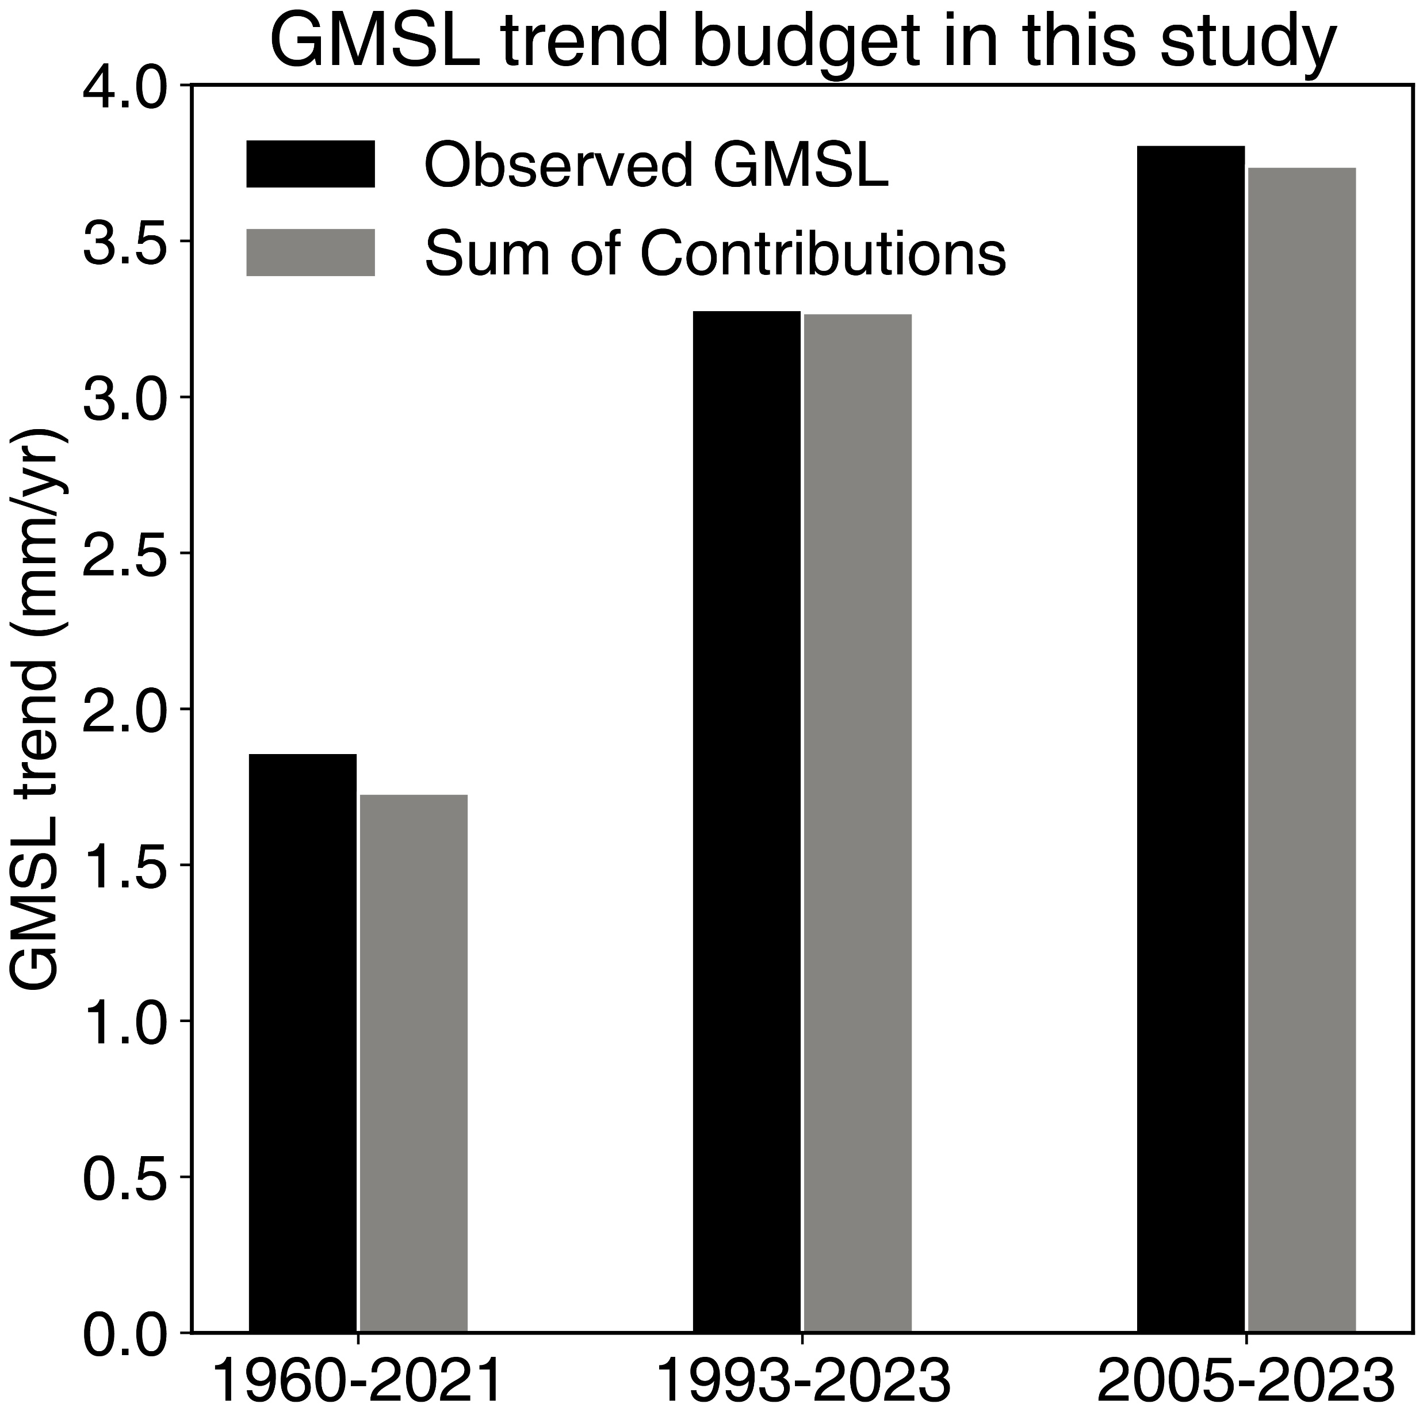
Sea Level Budget: trend
2005-2023:
Observed: 3.81 ± 0.31
Contributions: 3.74 ± 0.21
Residual: 0.07
1993-2023:
Observed: 3.28 ± 0.31
Contributions: 3.27 ± 0.17
Residual: 0.01
1960-2021:
Observed:1.86 ± 0.14
Contributions:1.73 ± 0.13
Residual: 0.13
Notes:
Here is the trend budget. The black bar is , the grey bar is . We found the trend is increase from 1.86 since 1960 to 3.81 since 2005. And The gaps between observed GMSL and sum of contributions is small.

Slide 10
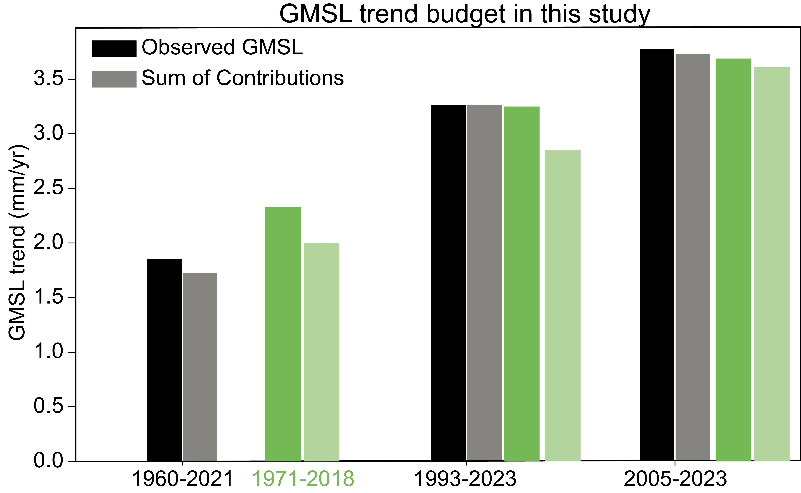
Sea Level Budget: trend
2005-2023:
Observed: 3.81 ± 0.31
Contributions: 3.74 ± 0.21
Residual: 0.07
IPCC residual: 0.08
1993-2023:
Observed: 3.28 ± 0.31
Contributions: 3.27 ± 0.17
Residual: 0.01
IPCC residual: 0.40
1960-2021:
Observed:1.86 ± 0.14
Contributions:1.73 ± 0.13
Residual: 0.13
IPCC residual: 0.33
Notes:
The missing contribution is amlsot resolved.

Slide 11
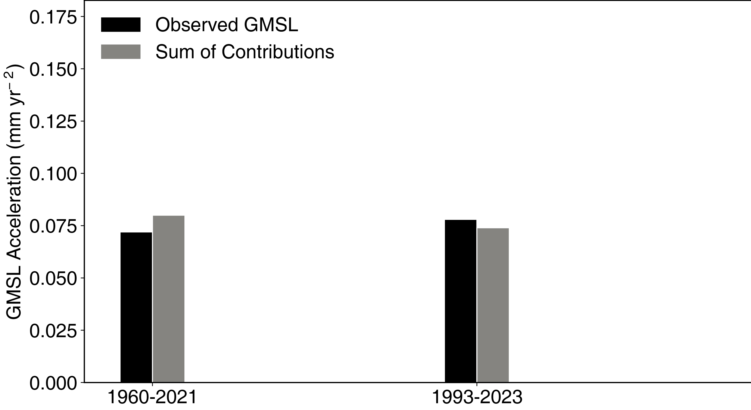
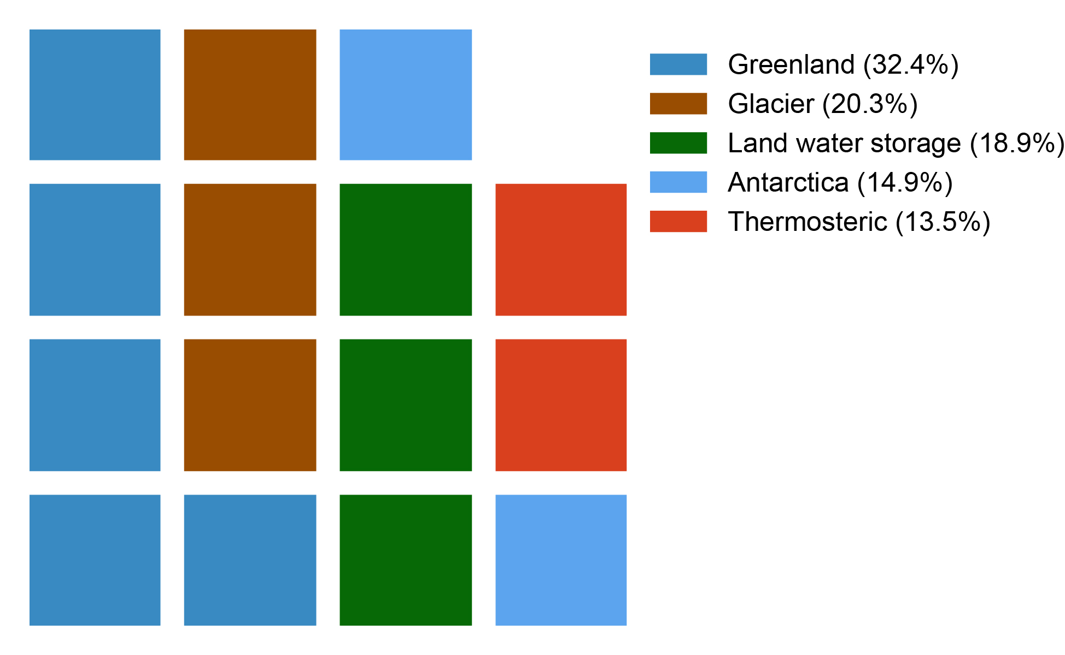
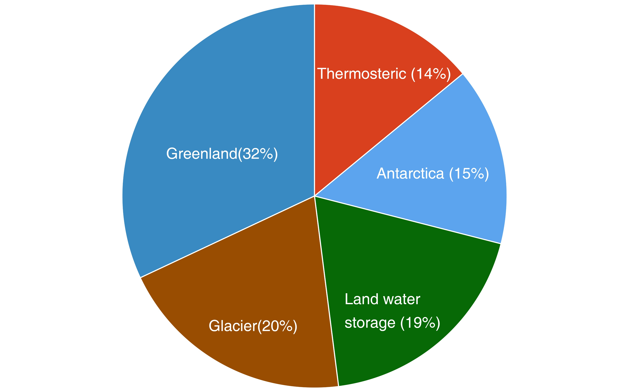
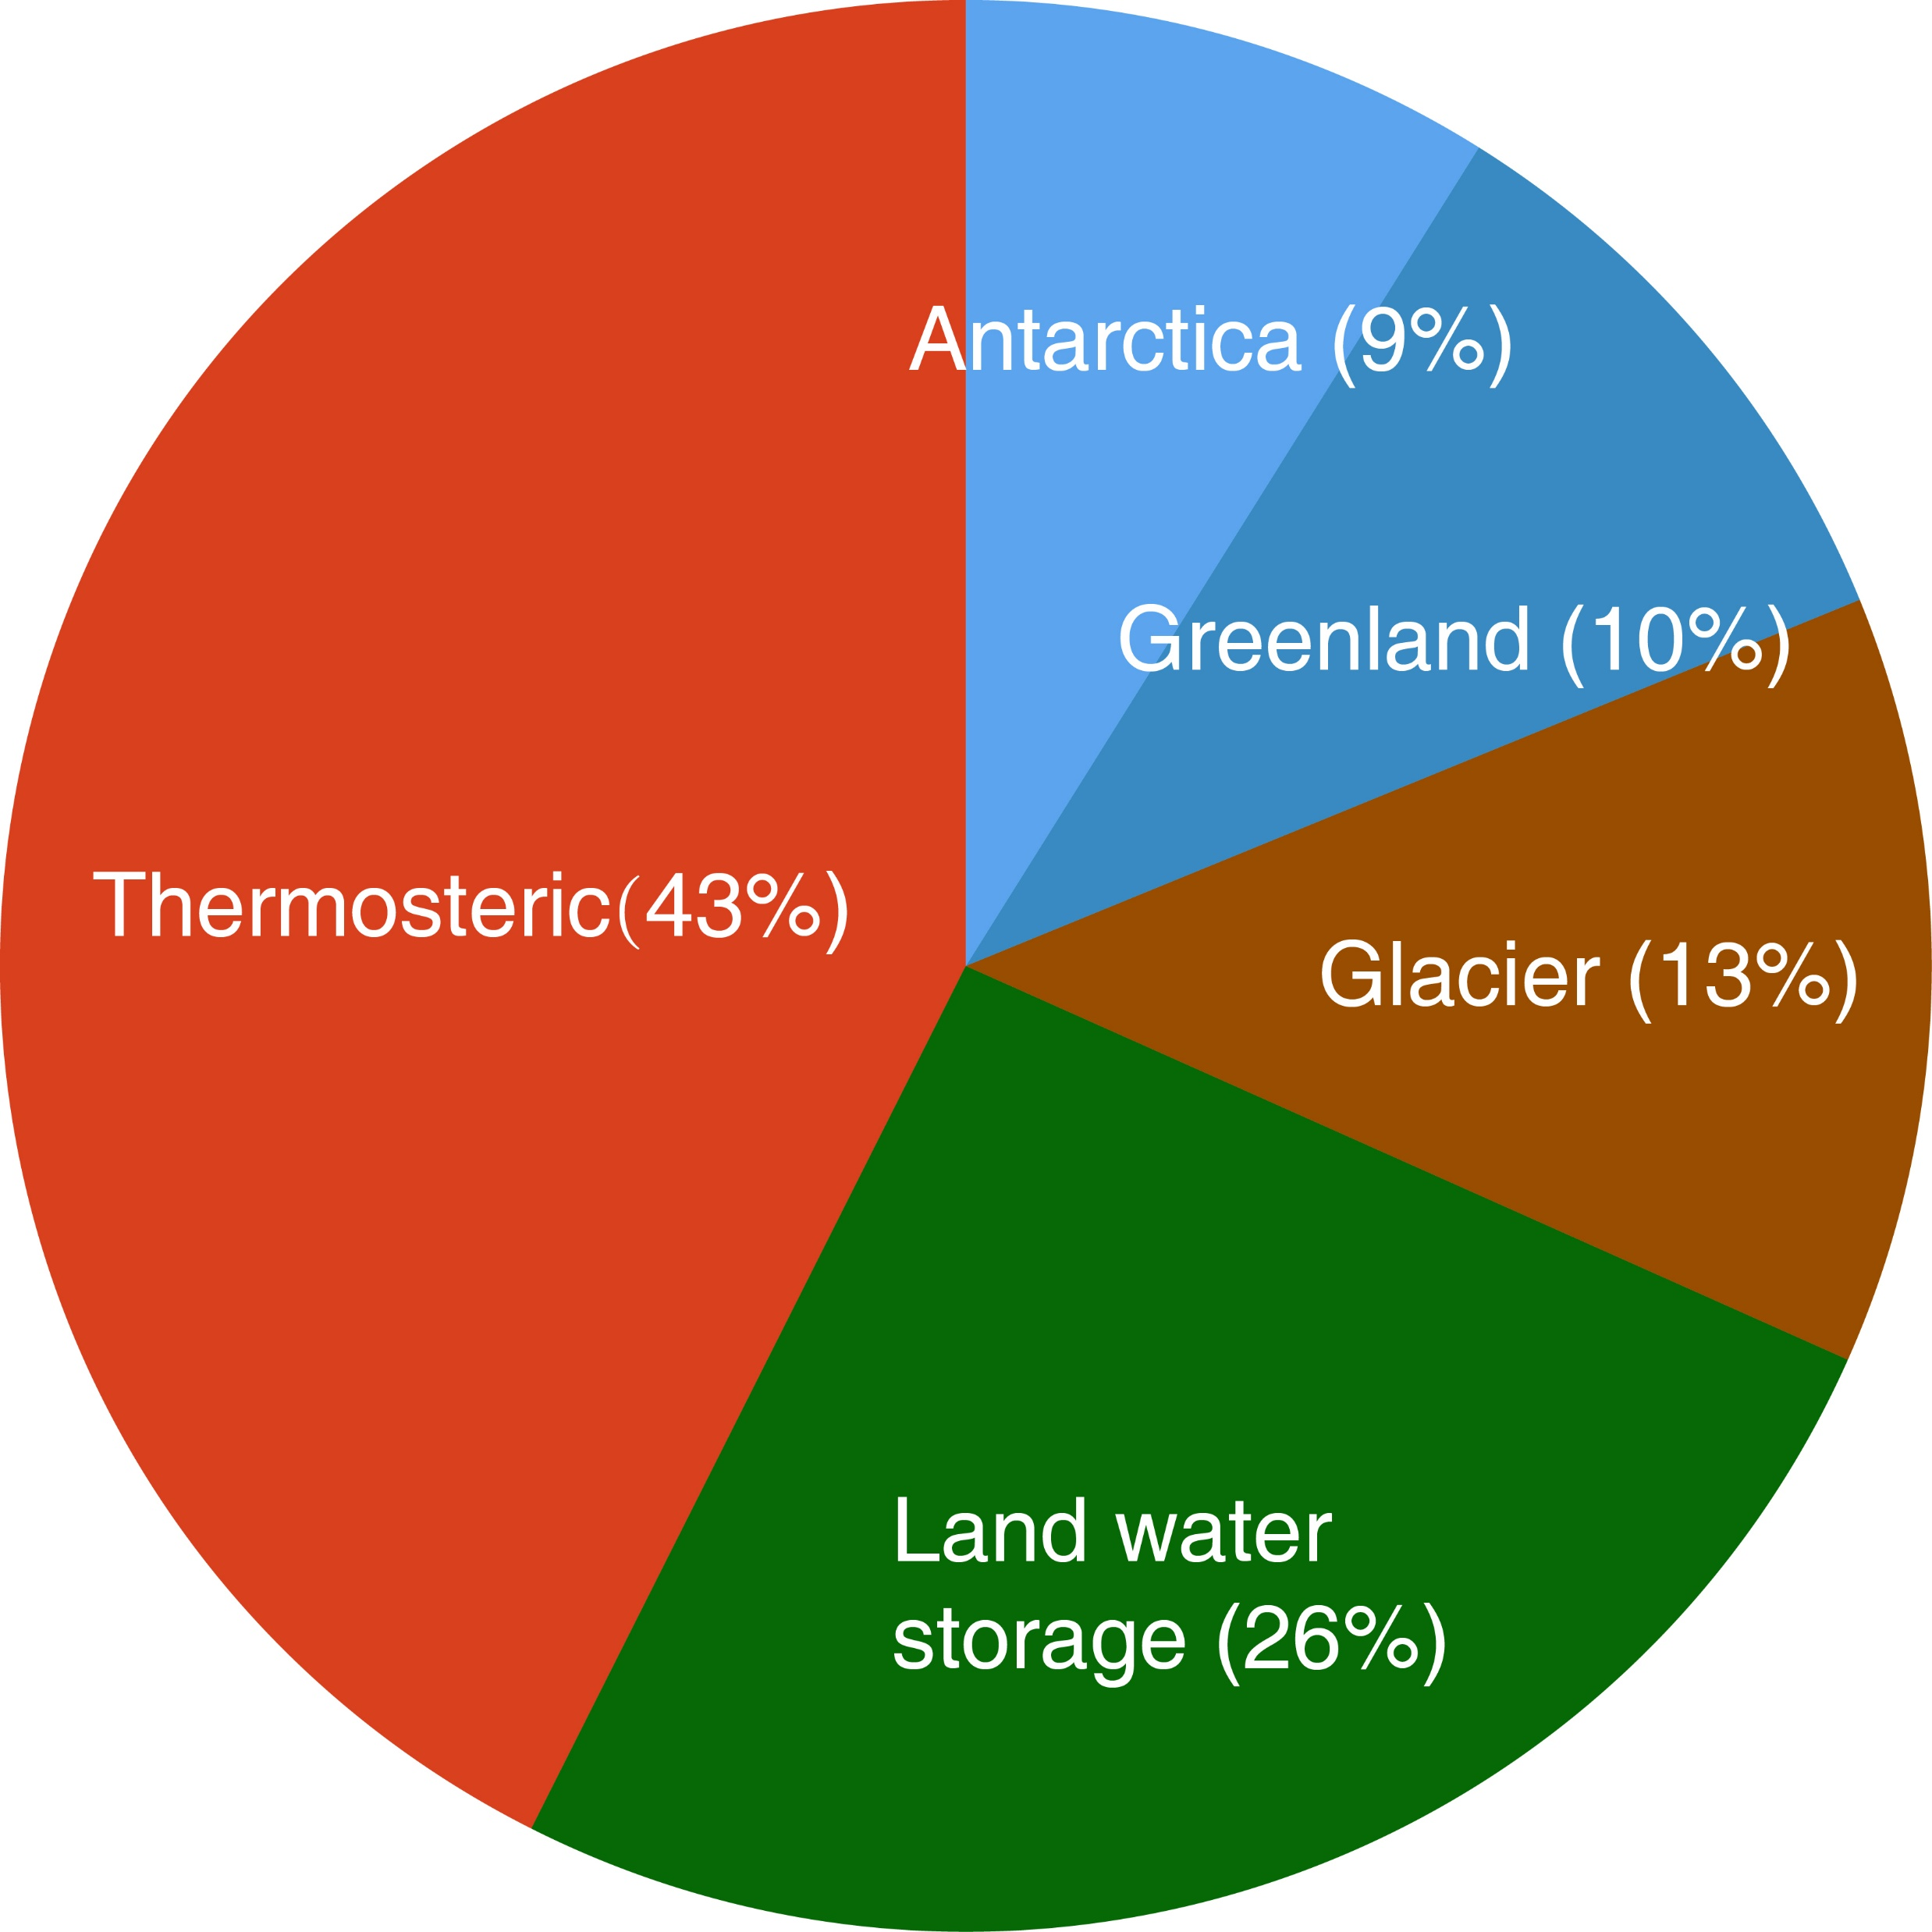
Sea Level Budget: acceleration
Observed: 0.083 ± 0.049
Contributions: 0.074 ± 0.013
Residual: 0.09
Observed: 0.072 ± 0.005
Contributions: 0.080 ± 0.005
Residual:-0.08
Notes:
Here is for acceleration budget. Although both satellite and tide guage have found GMSL is accelerating, the key drivers are unclear. An important problem is whether the contributions acceleration can match that of observed GMSL. By using most recent improved dataset, we find they do in 1960-2021 and 1993-2021. The acceleration of GMSL over 1960-2021 is mainly drivern by thermosteric sea level and land water storage.

Slide 12
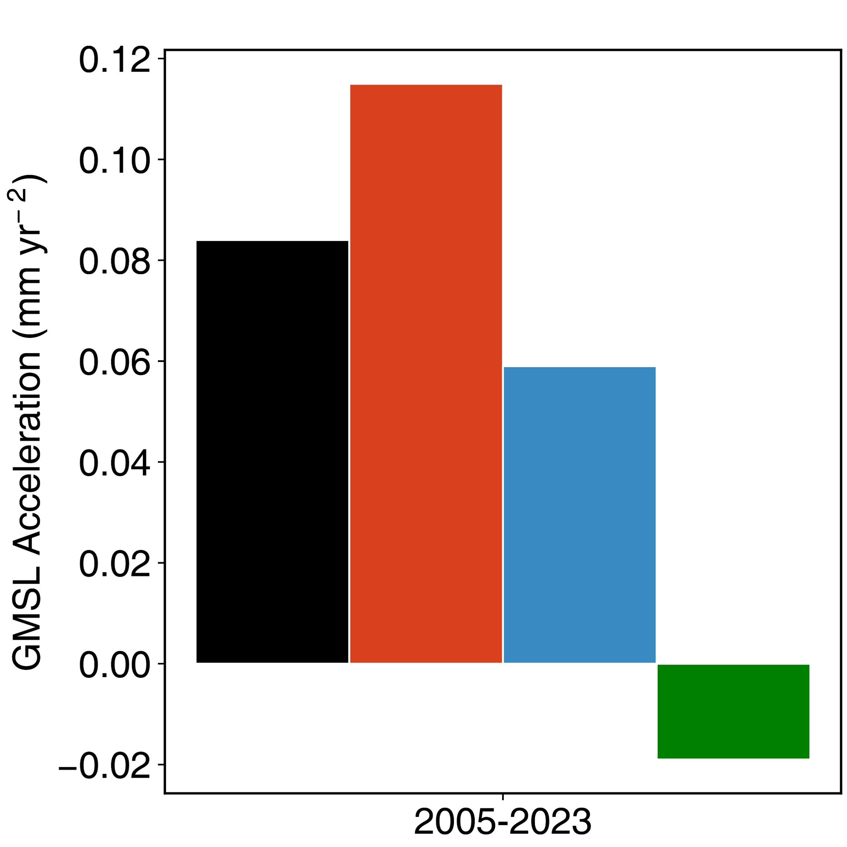
Sea Level Budget: acceleration
Observed GMSL: 0.084 + 0.066
Thermosteric: 0.115 ± 0.016
Ocean mass sum: 0.059 ± 0.006
Ocean mass from GRACE: -0.019 ± 0.027
0.174+17
Representation of short-term variability is still challenging on global-scale
Based on thermosteric and ocean mass from GRACE
0.096 ± 0.055 mm yr⁻²
Notes:
For acceleration over 2005-2023, we find the sum of contribution can’t match observed GMSL. The Thermosteric acc is and ocean mass sum from glacier and is xxxx. The sum of two is much hiu

Slide 13
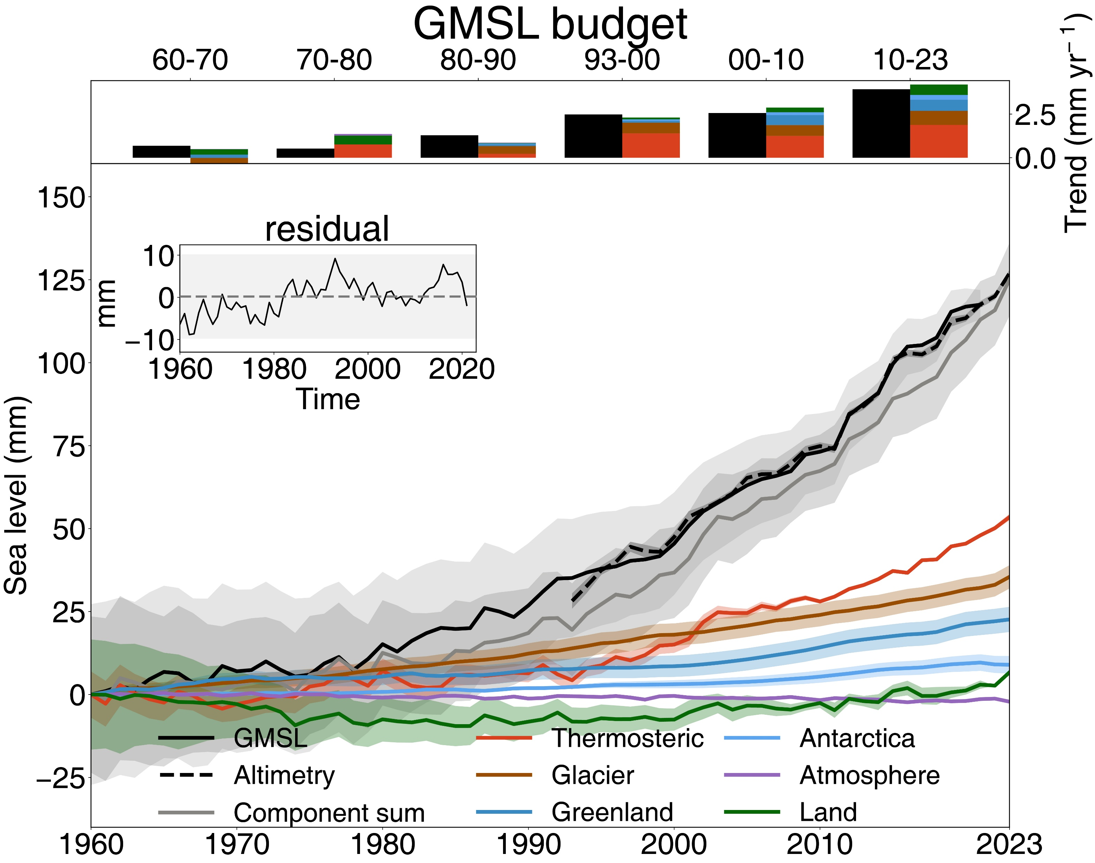
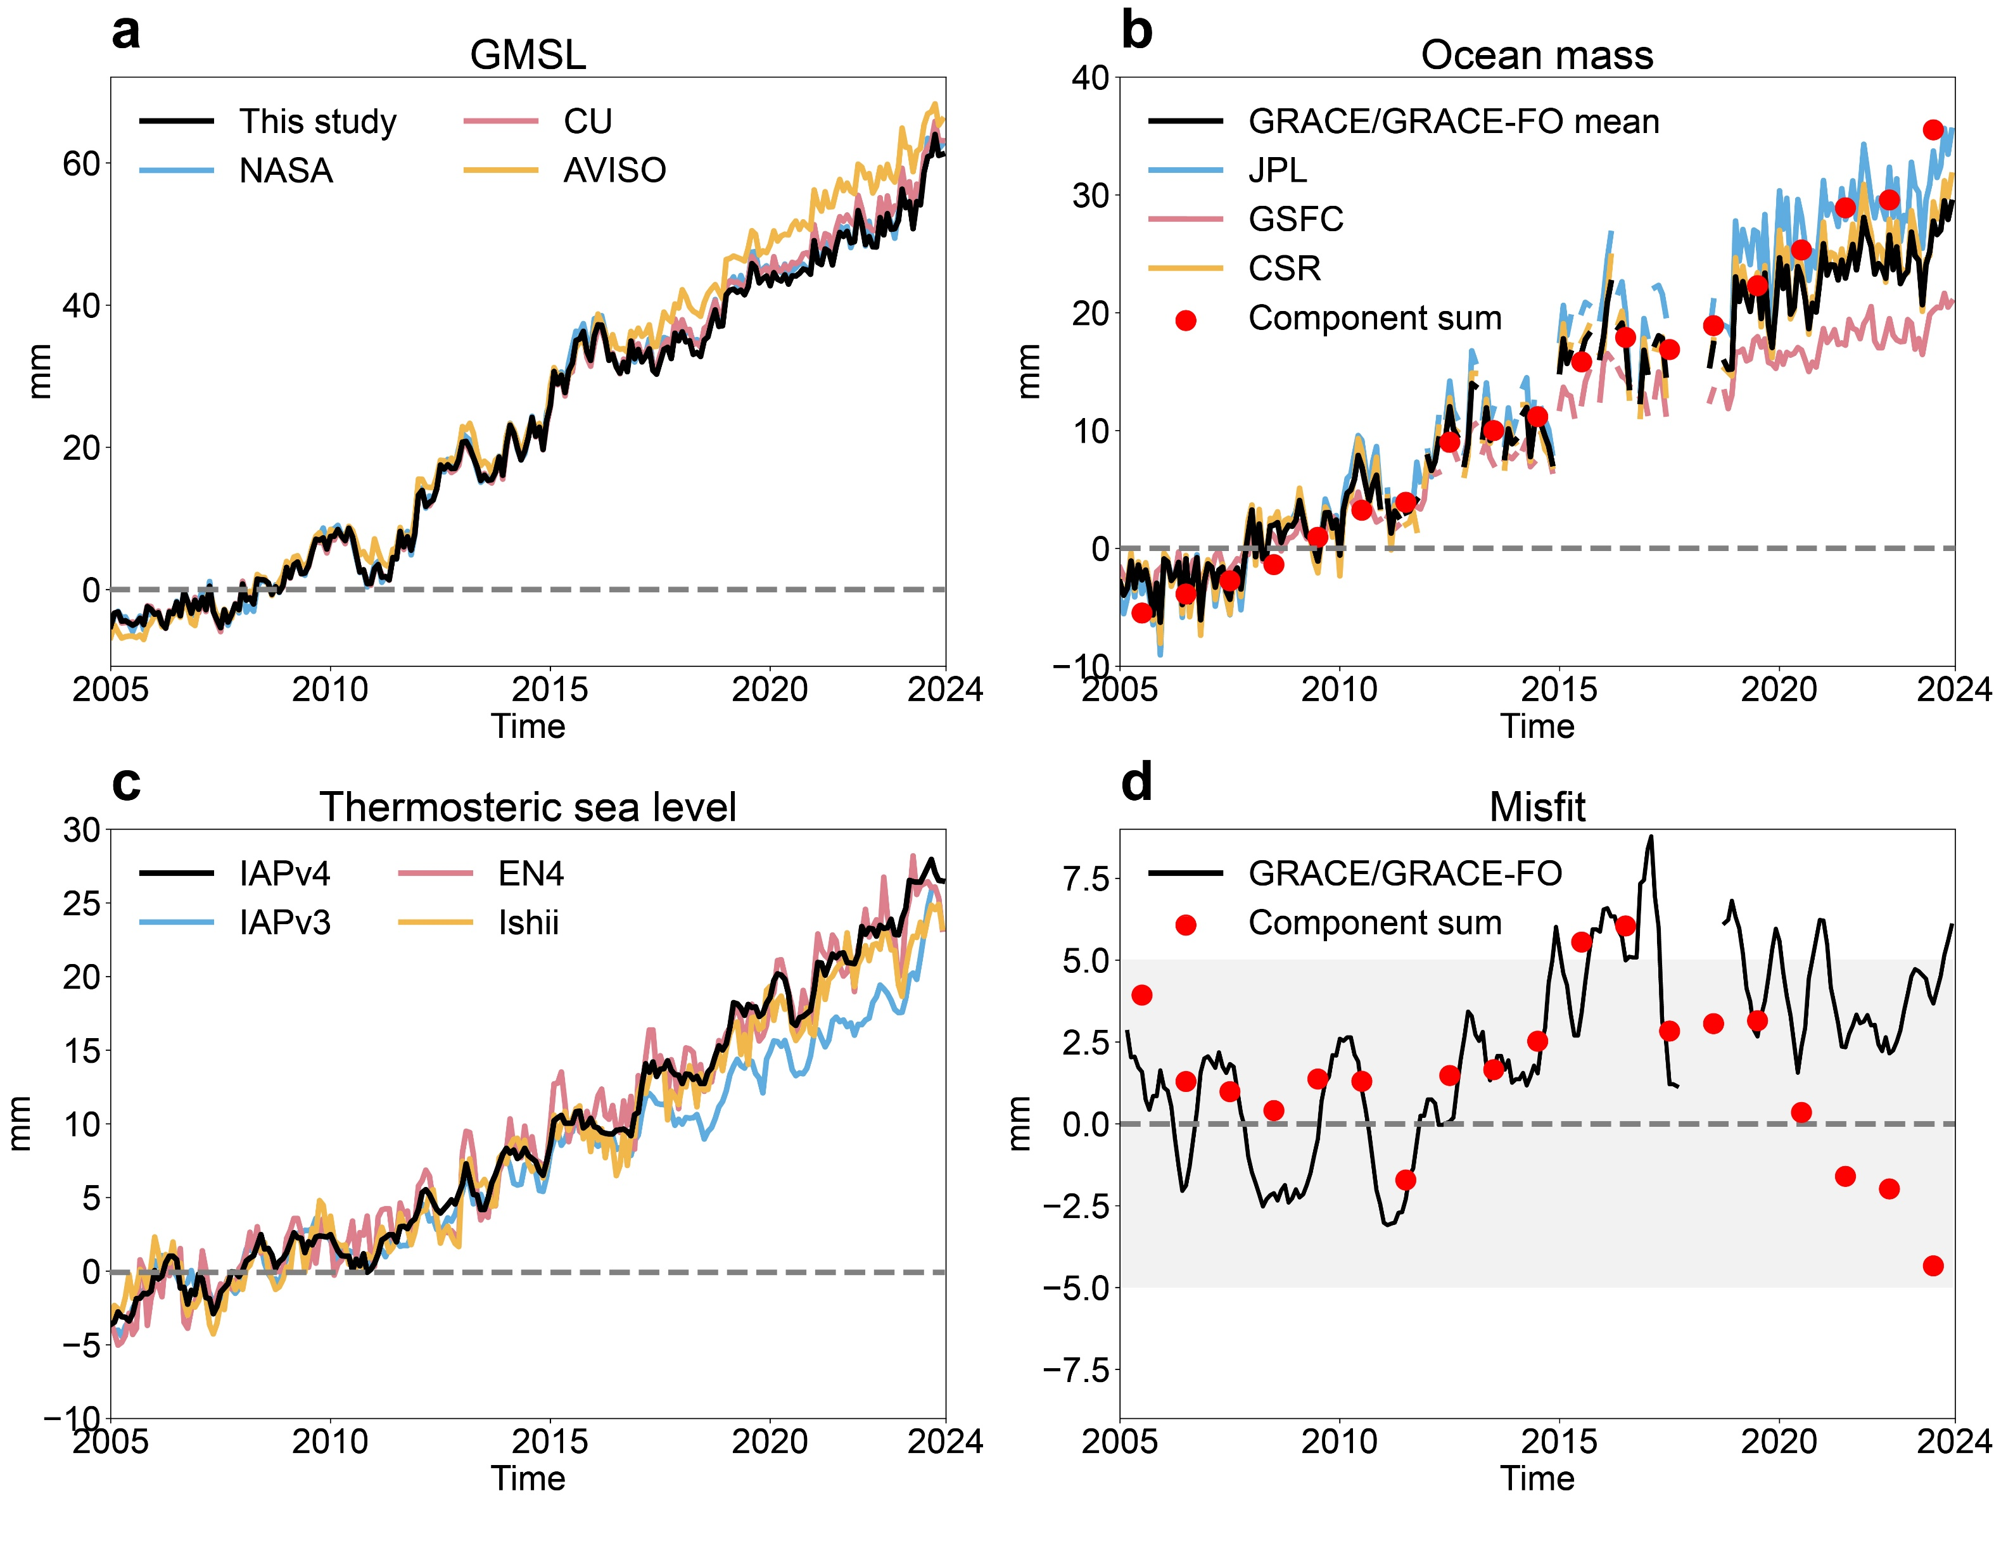
Sea Level Budget: temporal changes
The annual residual is limited to ±10mm since 1960 and even reduces to ±5mm after 2005.
Residual
Notes:
For example, the updated IAPv4 steric sea level and updated WTC correction can help reduce the residual GMSL budget in terms of trend and acceleration.

Slide 14
Take home message
The results highlight the importance of adequate data processing and bias corrections in climate change analyses.
Observation instrument bias correction
Mapping
wet troposphere correction in satellite altimetry
The residual in trend budget is almost resolved.
The acceleration budget is closed in all analysed periods.
The acceleration of GMSL is consistent within uncertainty for three periods, but the key driver differs.
The annual residual is limited to ±10mm since 1960 and even reduces to ±5mm after 2005.
Notes:
For example, the updated IAPv4 steric sea level and updated WTC correction can help reduce the residual GMSL budget in terms of trend and acceleration.

